Slide 1
INFO-6079
Security Application
INFO-6079
Security Application
Introduction to Python
Week 1

Slide 2
INTRODUCTION
Bruce Hansen
B_hansen42071@fanshaweonline.ca
G3001 by appointment only

Slide 3
INTRODUCTION
In computer industry over 45 years
Programming for over 35 years
Teaching at Fanshawe
Continuing Education - 10 years
Professor since 2015 - 8 years

Slide 4
Lecture will cover
What is Python
Installation of Python Initial Lab
Installation of Wing Initial Lab
Basic mathematical commands
Getting Started with the Basics

Slide 5
What is python?
an interpreted, object-oriented, high-level programming language with dynamic semantics.
high-level built in data structures, combined with dynamic typing and dynamic binding, make it very attractive for Rapid Application Development, as well as for use as a scripting or glue language to connect existing components together.

Slide 6
What is python ….
simple, easy to learn syntax emphasizes readability and therefore reduces the cost of program maintenance.
supports modules and packages, which encourages program modularity and code reuse.
The Python interpreter and the extensive standard library are available in source or binary form without charge for all major platforms and can be freely distributed.

Slide 7
What is python Used for?
Testing Systems and Networks
System Scripting
Developing software
games, websites, and software
Science research
Machine Learning
IOT Development

Slide 8
Why Python 3 and not 2 ?
Latest update is that Python 3.10
You will see Python 2.7 in near future
In some situation in work world you may need Python 2.7 next few years.
In class you only need Python 3.10
There are differences between Python 2 and Python 3

Slide 9
Python 3 vs Python 2
The first version of the Python 3.x was released at the end of 2008.
changes that made some of the old Python 2.x code incompatible. In this section, we will discuss the difference between the two versions.
The most compelling reason for porting to Python 3 is,
Python 2.x will not be developed after 2020.
it’s no longer a good idea to start new projects in Python 2.x.
There won’t ever be a Python 2.8.
Python 2.7 will only get security updates from the Python 3 development branch.
most of the code we write will work on either version with some small caveats

Slide 10
Why learn Python?
Easy to Learn and Use
Highly Flexible and Extensible
has a library to cater to your every need.
makes web development a breeze
plenty for Data Visualization
comes with numerous testing frameworks
excellent for Enterprise Application Integration (EAI)
great for scripting
Python is backed by an active community
Python skills can command high salaries

Slide 11
Why is Python popular
Easy to Learn
Mature and Supportive Python Community
Support from Renowned Corporate Sponsors
Hundreds of Python Libraries and Frameworks
Versatility, Efficiency, Reliability, and Speed
Big data, Machine Learning and Cloud Computing
First-choice Language
Flexibility of Python
Use of python in academics
Automation

Slide 12
Key Takeaways
Python provides a direct interface known as a Python Console to interact and execute the code directly. The advanced version of the Python console is the IPython (Interactive Python) console.
A whole number is called an integer and a fractional number is called a float. They are represented by int and float data types respectively.
Expressions are evaluated from left to right in Python. An expression with a float value as input will return the float output.
Strings are immutable in Python. They are written using a single quote or double quote and are represented by str data type. Any characters enclosed within quotes is considered a string.
Comments are used to annotate code. In Python, # character marks the beginning of a single line comment. Python discards anything written after the #.
Use the type() function to determine the type of data, print() to print on the standard output device and format() to format the output.
Use the escape character to escape certain characters within a string. They can be used to mark tab within a line, a new line within a string and so on.
Blocks of code are separated using indentation in Python. Code statements which go together within a single block must have the same indentation otherwise python will generate an Indentation error.

Slide 13
Python 3.11 Installation python revision 3.11

Slide 14
IDE Installs : Wing IDE used in this class : Pycharm or other IDE can be used

Slide 15
Basic mathematical commands

Slide 16
Adding and Subtracting
+ means plus
11 + 56 gives 67
-2 + 121 gives 119
- means minus
54 - 23 gives 31
23 - 54 gives -31
Notes:
Can use + sign to combine strings but not numbers to a string. If you want to add a number you need to put it in quotes

Slide 17
Dividing
Three (3) types
With a single forward slash / is division
8 / 5 would give 1.6
/ results floats, 2.5, 4.0, -9.25555555
With double forward slashes //
8 // 5 will give 1
// Floor Division. If only integers are involved than will get integer, discarding decimal. If there is a float than would get decimal point of 0.
Positive numbers will be rounded to 0 and negative numbers a way form 0.
% is modulo. Will return the reminder, as integer
8 % 5 will give 3
Notes:
We will talk what are Integers and floats later in the lecture
Integers are whole numbers without decimal points
Floats are real numbers with decimal point

Slide 18
Multiplication
To multiple use a single *
4 * 5 will give 20
5 * 4 will also give 20
To exponentiation/power use **
4 ** 5 will give 1024 (= 4 x 4 x 4 x 4 x 4)
This is 4 to the power of 5
5 ** 4 will give 625 ( = 5 x 5 x 5 x 5)

Slide 19
Python order of precedence
Top to bottom
**
- (negation)
*, /, //, %
Adding and subtraction

Slide 20
Works with variables
Test1 = 90.5
Test2 = 97
Test3 = 85.5
Course_average = (Test1 + Test2 +Test3) / 3
Gives you 91.0

Slide 21
Python Basics

Slide 22
Getting Started
Literal Constants
Variables
Numbers
Strings
Comments
Print() function
Format() function
Input() function
Escape
Indentation

Slide 23
Literal Constants
Some more concrete examples
numeric literals are 5, 2.85
string literals are
“I am a string” or “Welcome to EPAT!. Python Basics”
It is called a literal because we use its value literally.
The number 5 always represents itself and nothing else -- it is a constant because its value cannot be changed.
Similarly, value 2.85 represents itself. Hence, all these are said to be a literal constant.

Slide 24
Variables
Form: variable_name = expression
The expression on right side (RHS) produces a value, which has a memory address.
Store the memory address in the variable on the left-hand side (LHS).
If the variable exists it is reused, otherwise a new variable is created

Slide 25
Variables: Assignment Statement
year = 2019
Results in an integer, whole number
year = ‘twenty-nineteen’
year is reused
school = ‘Fanshawe College’
school = ‘It”s’
No difference between single or double quotes.
Quote = ‘Prof said “Lab are due”’
Prints: Prof said “Labs are due.”
Notes:
A number with no quotes will result in an integer or float, if there is a decimal point.

Slide 26
Terminology
For statement: year = 2023
We say:
year gets 2023
year refers to the value 2023

Slide 27
Variable Names
Must start with a letter or underscore ( _ )
Can only include letters, digits, & underscores
Valid: _wulf_dog, School, MY_Address
Invalid: 2019grades, @school

Slide 28
Variable Names
Case matters: Age, age, and aGe are 3 different variables
Use meaning full names
Avoid using random names
If you keeping IP address name it IP4, IP6, or server_IP4 not location. This way you know this is the server’s IP4 address not third floor

Slide 29
Python is Dynamic references
Unlike other programing languages, Python object references have no type associated to them.
Could do the following:
Age = 22
Age = ‘twenty-two’
Age = 2.5
Notes:
When changing the value of Age there wont be an error

Slide 30
Everything in Python is an Object
Python interpreter sees everything as its own “box”, called Python object
This includes:
Each variable,
Data structures,
functions,
Class,
modules
An object is a collection of functions (methods), variables and attributes (properties).
We will learn all of these in the next couple of weeks

Slide 31
Scalar Types
Scalar types are build-in types that can hold a single value.
int – an integer (whole numbers) : 1, 1000, -3
Float -floating point number (64-bit): 3.14, 0.15
Str – string, a sequence of characters (can contain Unicode characters)
None –Python null value
Bytes – Raw ASCII bytes (or Unicode encoded as bytes)
Bool – True or False
Notes:
String can be numbers, letters, or special characters

Slide 32
Strings
Simply put, a string is a sequence of characters.
strings are almost everywhere in Python code. Python supports both ASCII and Unicode strings.
Single Quote
We can specify a string using single quotes such as 'Python is an easy programming language!’.
All spaces and tabs within the quotes are preserved as-is.
Double Quotes
We can also specify string using double quotes such as "Yes! Indeed, Python is easy.".
Double quotes work the same way single quotes works. Either can be used.

Slide 33
Strings . . .
Strings are immutable
This means once we have created a string we cannot change it.
Consider the following example
month_name = 'Fanuary’
Trying to correct the value will create an error
month_name[0] = ‘J’
The proper fix is to type
month_name = ‘January’

Slide 34
Comments
# tells Python interpreter ignore rest of the line
print (“Hello world”) # prints greeting
Python only outputs Hello world
Comments can also be at the start of the line
# This is also a comment!
Multi line comments
Python does not support multi-line/block comments. However, we can span comments across multiple lines using the same triple single quotes
‘’’ this
Is a multiline comment ‘’’

Slide 35
Comments …
It is always a good programming practice to generously intersperse our code with comments.
Remember: The code tells you how, the comment tells you why
Example File Header
# Function: to do this
# Date Winter 2023
# Author: Bruce Hansen
# -----------------------------

Slide 36
print()
The print() function is a very versatile tool that is used to print anything in Python.
NOTE: In Python 2, print is just a statement without parenthesis and NOT a function, whereas in Python 3, print() is a function and the content that we need as an output goes inside a parenthesis.
examples to understand how the print() works.
Simple print function
Concatenating string and integer literal
Concatenating two strings
Concatenating a variable and string

Slide 37
input()
Python input() is a built-in function used to read a string from standard input.
The standard input in most cases would be your keyboard.
Syntax – input()
Following is the syntax of input() function.
x = input(prompt)
where value entered is returned as a string.
The prompt is helpful in letting the users know what kind of input the application is expecting, something like a clue. Prompt is optional though.
input() function returns the string keyed in by user in the standard input.
Examples

Slide 38
format()
Another useful function for printing and constructing string for output is format() function.
Using this function, we can construct a string from information like variables.
Consider the following code snippet.
stock_ticker = 'AAPL’
price = 226.41
print('We are interested in {x} which is currently trading at {y}'.format(x=stock_ticker, y=price))
Or
print('We are interested in {0} which is currently trading at {1}'.format(stock_ticker, price))

Slide 39
Escape Sequence
Escape characters are generally used to perform certain tasks and their usage in code directs the compiler to take a suitable action mapped to that character. Suppose we want to write a string That's really easy..
If we are to write this within a double quote ", we could write it as "That's really easy."
but what if we are to write the same string within single quote like 'That's really easy.’
we cannot write it because we have three ' and the Python interpreter will get confused as to where the string starts and ends.
Hence, we need to specify that the string does not end at s in the string, instead, it is a part of the string.
We can achieve this by using the escape sequence. We can specify it by using a \ (backslash character). For example,
'That\'s really easy.’
"That's really easy."

Slide 40
Escape Sequence …
Another useful escape character is \t tab escape sequence.
It is used to leave tab spaces between strings.
print('AAPL.\tNIFTY50.\tDJIA.\tNIKKEI225.’)
In a string, if we are to mention a single \ at the end of the line, it indicates that the string is continued in the next line and no new line is added.
print('AAPL is the ticker for Apple Inc. \
It is a technology company.’)
Another useful escape character is \n newline escape sequence. It is used to enter a newline or line break
print('That is really easy.\nYes, it really is.')

Slide 41
Indentation
Whitespaces are important in Python.
Whitespace at the start of a line is called indentation.
It is used to mark the start of a new code block. A block or code block is a group of statements in a program or a script.
Leading spaces at the beginning of a line are used to determine the indentation level, which in turn is used to determine the grouping of statements.
Also, statements which go together must have same indentation level. A wrong indentation raises the error.
stock_name = 'AAPL’
# Incorrect indentation. Note a whitespace at # the beginning of line.
print('Stock name is', stock_name)
# Correct indentation.
print('Stock name is', stock_name)

Slide 42
Indentation …
Python works with indentations to define scope in the code.
A colon (:) denotes the start of the intended code block. All the code in the block have to be indented the same amount until the end of the block
We will see this in if statements, loops, functions, and classes

Slide 43
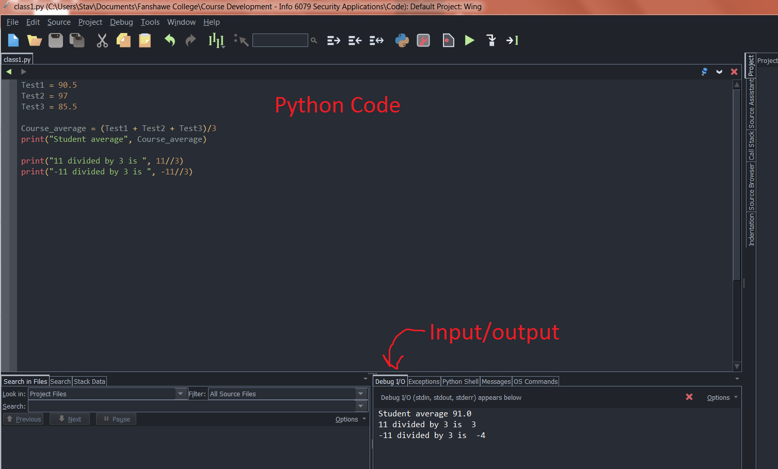
Code in Wing IDE

Slide 44
Before Lab 1
Download current version of Python 3.10 or later
https://www.python.org/downloads/
Download current version of Wing IDE, either personal or 101
https://wingware.com/downloads
This could save you time during the lab

